Slide 1
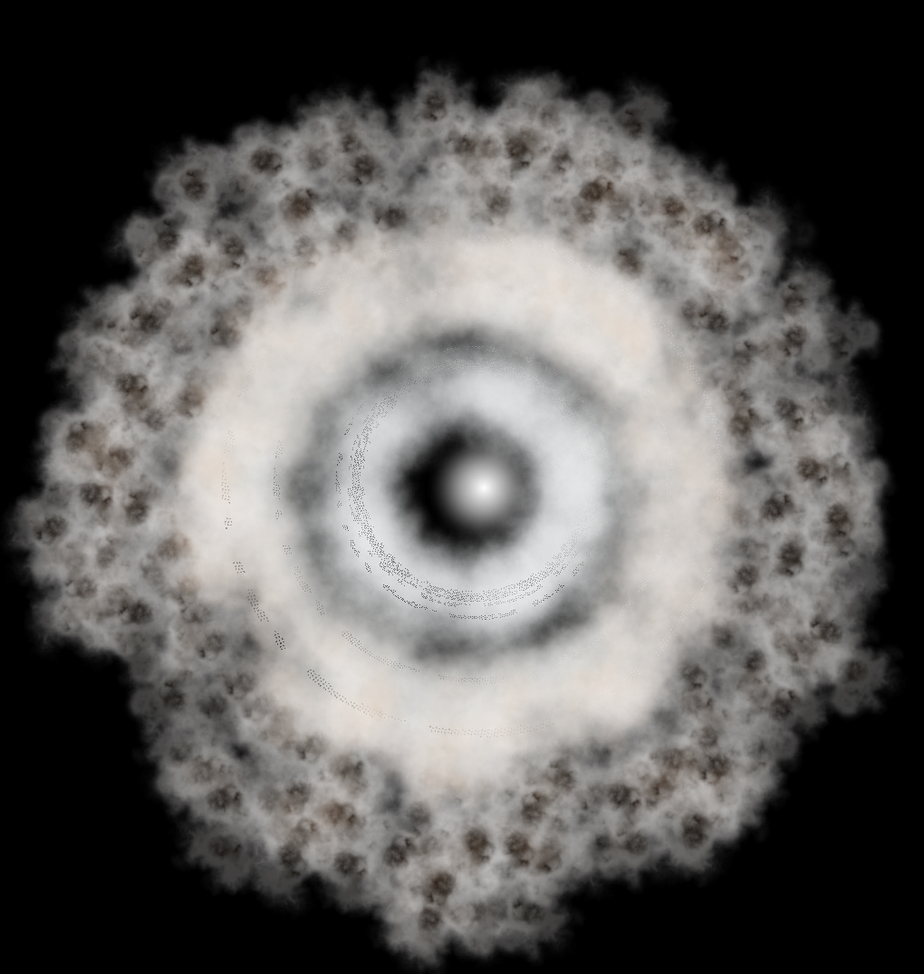


Duration: 80 min
High School
Grade: 9 - 12
CCSS, NGSS
Earth‘s history:
The beginning
Earth and space science, Geology

Slide 2

Lesson overview
The planet Earth has a more than 4.6 billion year history, over the course of which it has undergone substantial changes in the conditions it offers life. All living organisms have had to adapt to these changes; those that were unable died out. However the survivors have also contributed to the creation and alteration of these life conditions. This process of mutual influence between different elements of the environment is called coevolution, and it has contributed considerably to changing our planet.
Learning objectives
Keywords
Learn about the evolution and development of Earth and of the life forms which have inhabited it since its creation.
Understand the factors which have contributed to the formation of the environments on Earth over its history.
Observe the mutual influence of living nature on Earth’s systems.
Earth, Formation, Sun, Stars, Solar system, Planets, Galaxy, Milky Way, Moon
Standards
Common Core
CCSS ELA-Literacy W.9-10.7
Conduct short as well as more sustained research projects to answer a question (including a self-generated question) or solve a problem; narrow or broaden the inquiry when appropriate; demonstrating understanding of the subject under investigation.
SL.9-10.4
Present information, findings, and supporting evidence clearly, concisely, and logically such that listeners can follow the line of reasoning and the organization, development, substance, and style are appropriate to purpose, audience, and task.
W.9-10.8
Gather relevant information from multiple authoritative print and digital sources, using advanced searches effectively; assess the usefulness of each source in answering the research question; integrate information into the text selectively to maintain the flow of ideas, avoiding plagiarism and following a standard format for citation.
SL.9-10.5
Make strategic use of digital media (e.g., textual, graphical, audio, visual, and interactive elements) in presentations to enhance understanding of findings, reasoning, and evidence and to add interest.
NGSS
HS-ESS2-7
Construct an argument based on evidence about the simultaneous coevolution of Earth’s systems and life on Earth.
SL.9-10.1
Initiate and participate effectively in a range of collaborative discussions (one-on-one, in groups, and teacher-led) with diverse partners on grades
9–10 topics, texts, and issues.

Slide 3
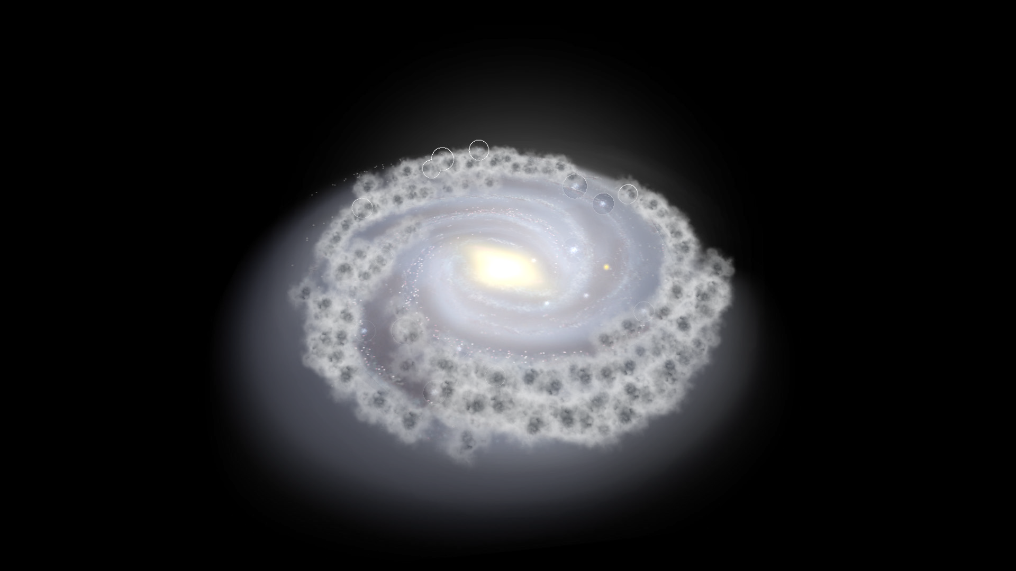
1. Introduction
5
min
Despite being only a speck in an immense universe, our planet Earth is unique. To date, it is the only planet we know of with life present, having developed there over the approximately 4.6 billion year existence of the planet. In comparison with other space objects, Earth is relatively small. It revolves around the Sun, an obscure star in the interior of the Milky Way galaxy. Go to the Lifeliqe app, browse the Astronomy library, and find the “Galaxy” model. Open it and ask the students to guess where the Sun is hidden. Can they see it? To discover its position, click on the Position of the sun part. Mention also the huge dimensions of our galaxy using the part Measure [Light Years] to help you and your students imagine its immensity!
Click to open in Lifeliqe

Slide 4
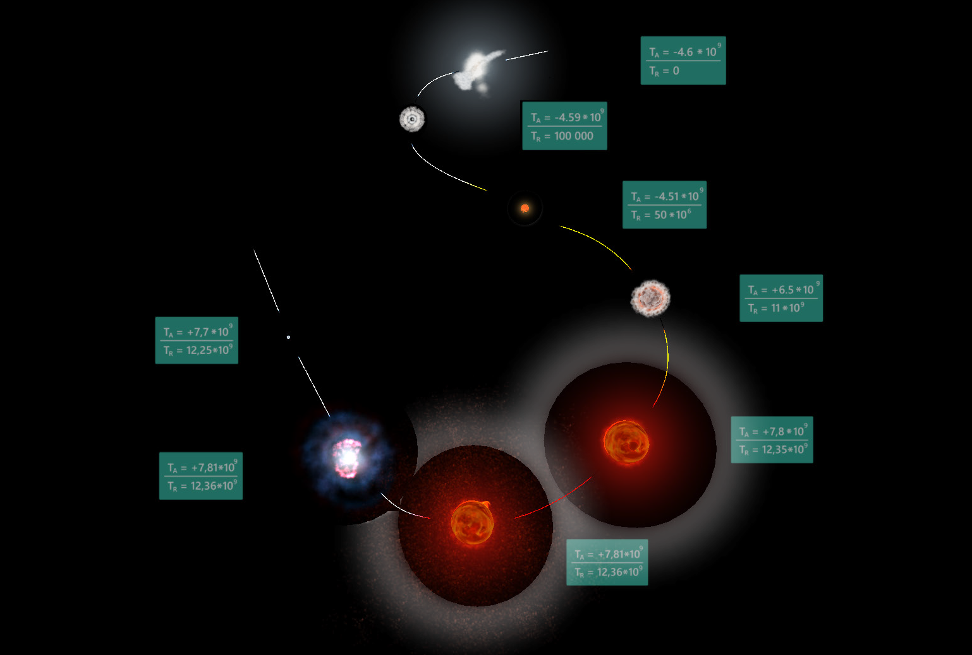
2. Formation of the Solar System
15
min
Crucial for the existence of life on Earth is its proximity to the star around which it revolves, the Sun. Earth and the seven other planets (among many other objects) revolving around the Sun form the Solar System. This system was formed relatively recently in the history of the universe: the scientific estimate of the total age of the Solar System (Earth included) is approximately one third the age of the universe as a whole. But how did such a system appear?
To answer this question, it might help you and your students to view another Lifeliqe model; go again to the Astronomy library, and find and display a model called “Evolution of Sunlike Stars”. Work through this model, beginning with the Timeline, where you can see the complete evolution of stars similar to the Sun.
Then begin an explanation of the formation process of planetary systems. Tell students that it all began in a gigantic cloud of interstellar gas and dust, called a nebula. This is shown in the first part of the Timeline, where you can find a model of the Carina Nebula, a nebula similar to the one existing at the beginning of Earth’s development. You can also see there a chronology of the formation of the Solar System. To focus on each of the models on the Timeline, click on the separate parts of each of the models, which appear below the Timeline list.

Slide 5
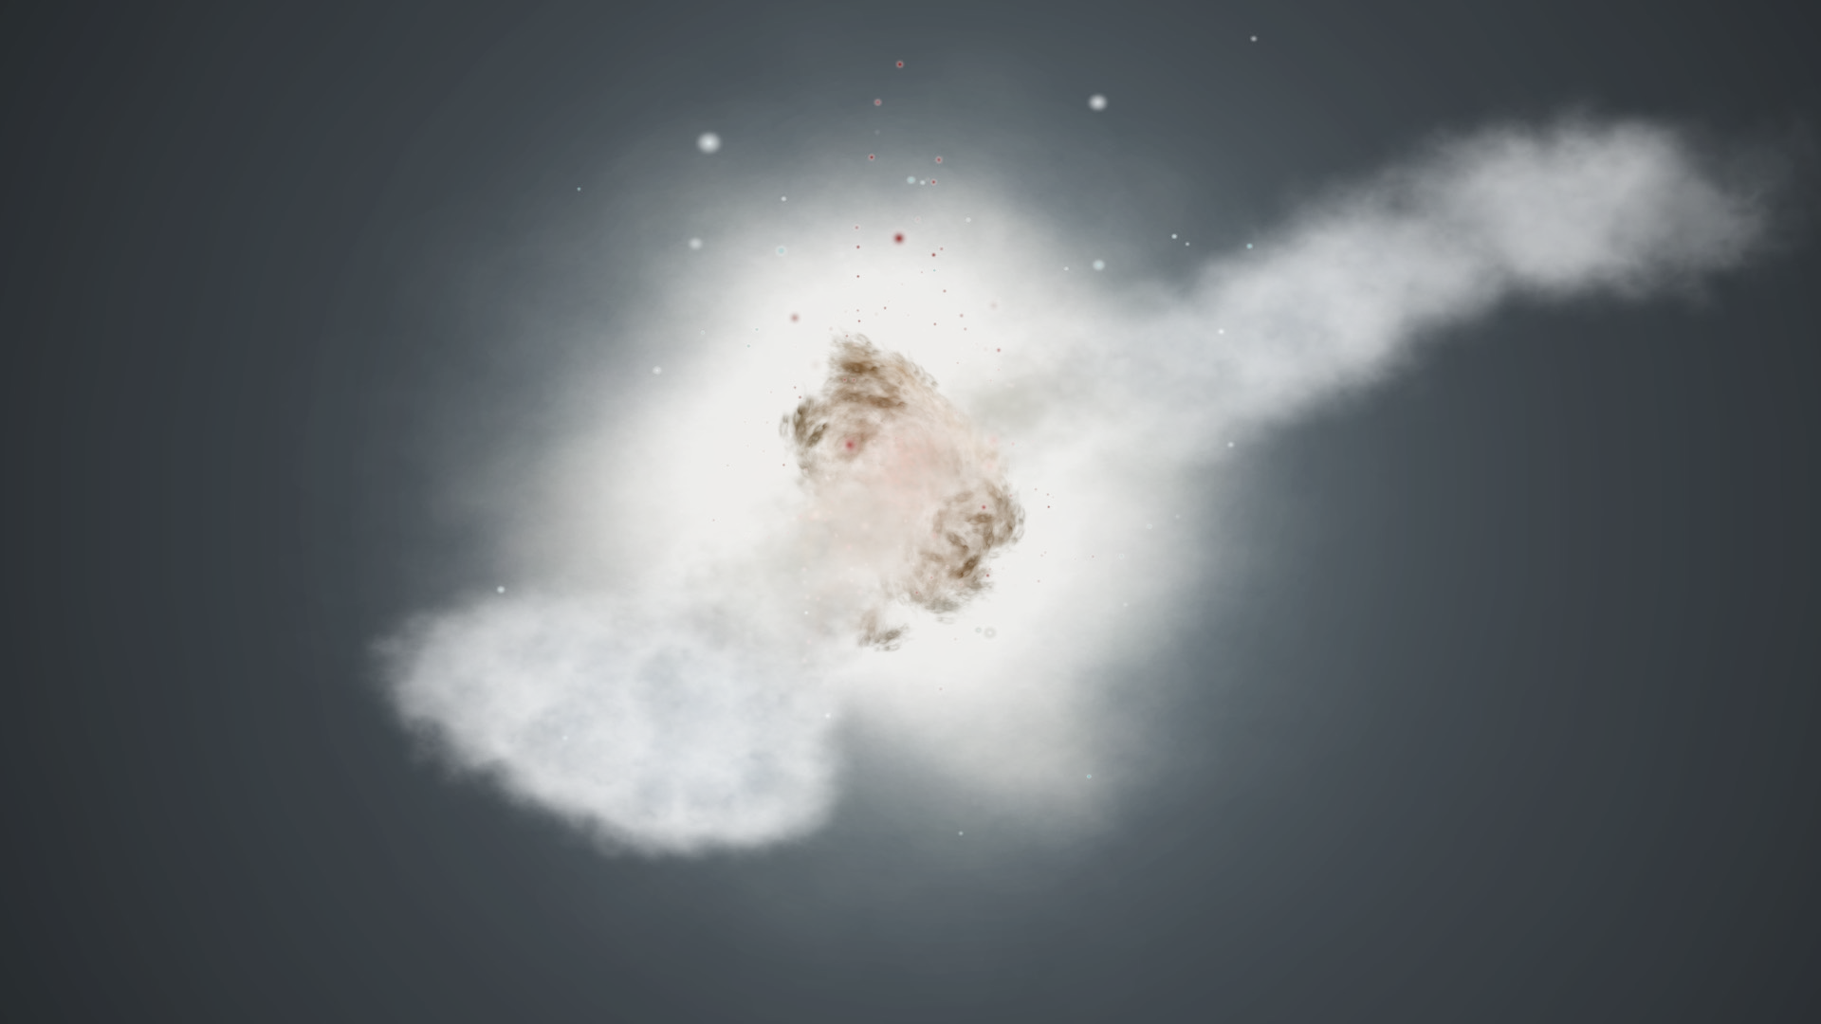
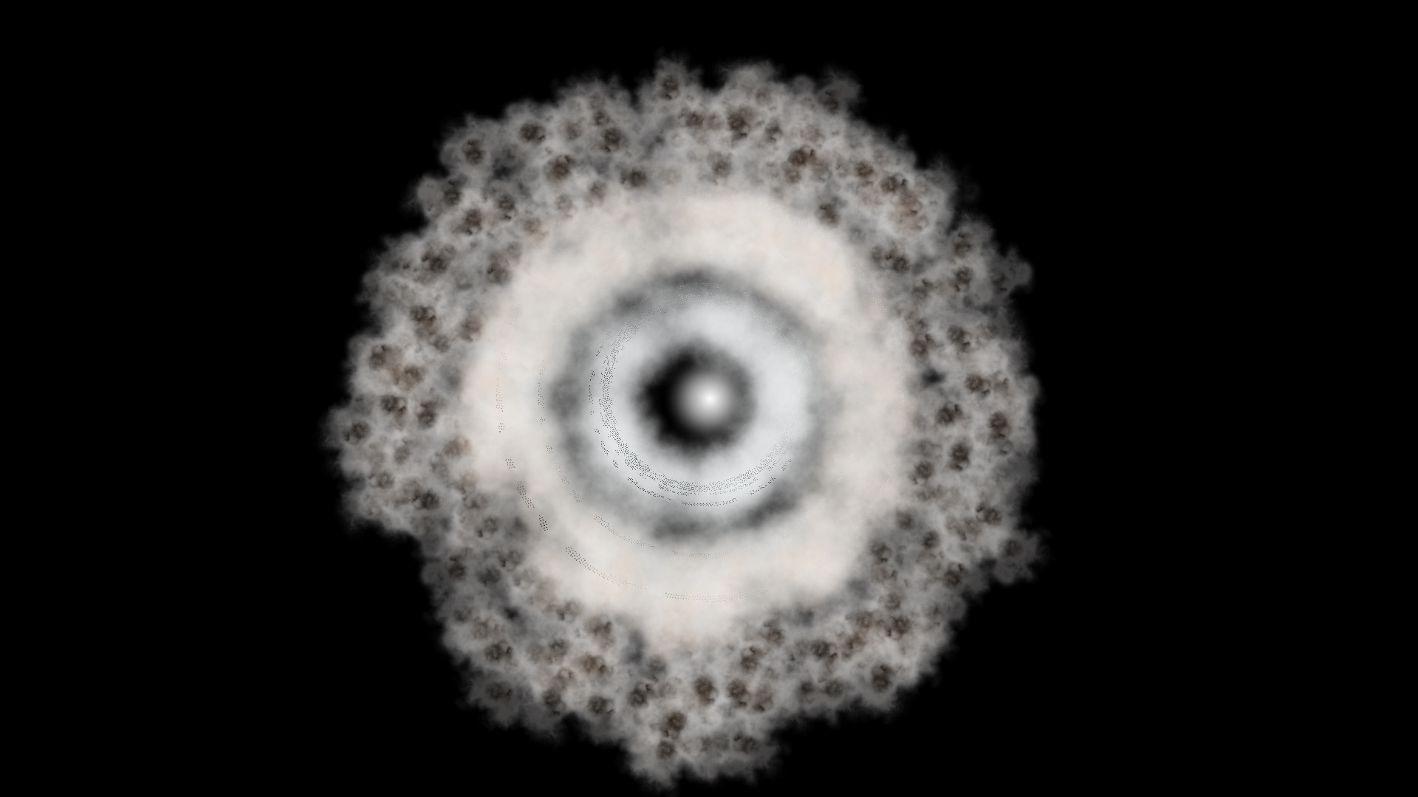
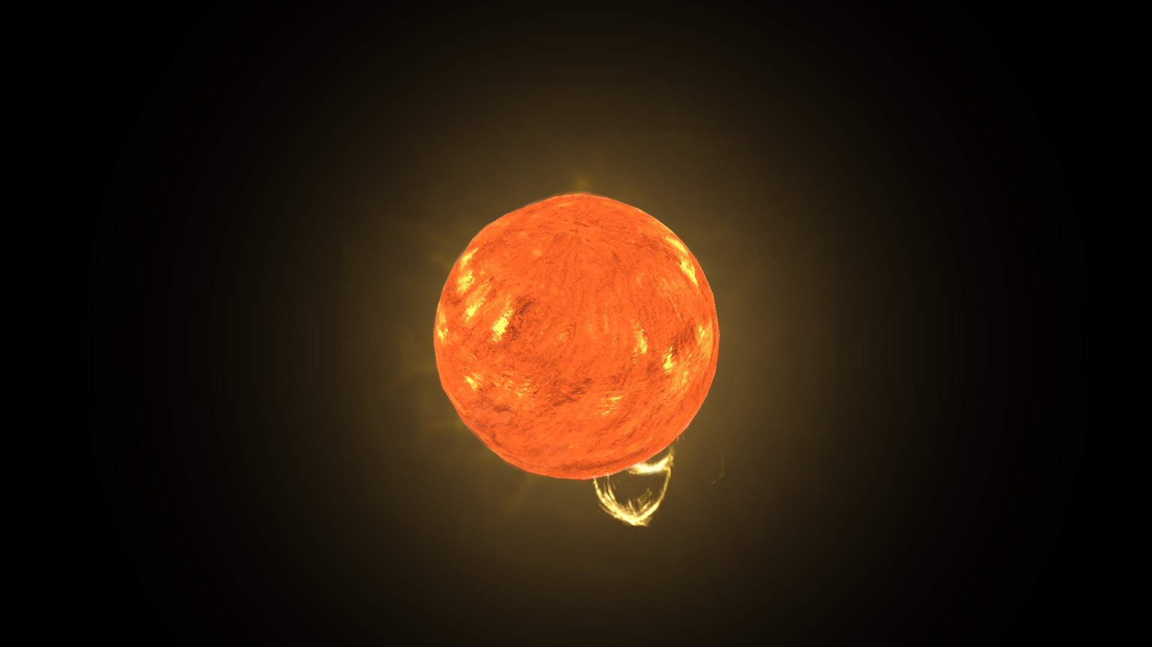
The next phase of star formation is called a Protostar, which arises thanks to the accretion of material in the solar nebula (Earth itself was also created by a similar accretion of material). In essence, an external stimulus, such as a star explosion nearby, caused the nebula to shrink, and thanks to its rotation, a protoplanetary disc was formed. In the centre, where the the greatest quantity of material accumulated, a protostar formed.
Then, following a long period of time, approximately 50 million years after the beginning of the whole process, the first thermonuclear reactions were ignited in the interior of the forming star, and so the Sun began to shine. The Sun is still in this phase of its life cycle, burning hydrogen and producing helium, and so emitting a huge amount of energy into the System it gives its name to. This energy is one reason why life appeared on Earth.
Click to open in Lifeliqe

Slide 6
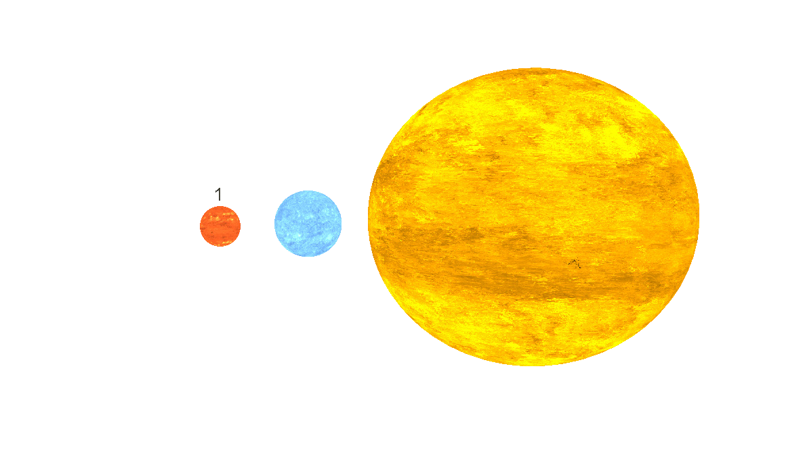

3. Earth’s position
20
min
Now students know the history of the formation of our Solar System in overview. The Sun is its heart, its gravitational center and the principal source of its light and thermal energy. In comparison to its planets, especially the small ones like Earth, the Sun is truly huge. However in comparison with other stars, the Sun is relatively small. To give students some idea of the comparative sizes of stars known in the universe, open the Lifeliqe model called “Size of Stars” found in the Astronomy library.
It consists of a scale of various stars, including also Earth in order to really show the size of these huge objects. Tell students that the Sun is in reality one of the smaller stars in our universe, and appears really quite little in comparison with the red giants found far off in the distant reaches of space.
As already mentioned, the Sun is the center of our Solar System. Students will surely be familiar with its general appearance, however there is a “Solar System” model if you would like to discuss it further. Open it and invite the students to observe some details about it:
Are all the planets the same or can we classify them by certain characteristics?
In what aspects are they different?
Which factors could be relevant when speaking about the composition of the planets and their position in the Solar system, and the favorability of these conditions for life to arise?
Discuss these questions with your students briefly. Then point out the first four planets, the so-called rocky planets, which have sizes similar to Earth’s and are the closest to it, and try to compare these planets, analyzing very briefly the general conditions for life on each of them (temperature, geological structure, chemical composition of their atmosphere, etc.). Find a model of each of the planets, show it, and find the relevant information using the description available in the Lifeliqe app itself, as well as other sources:

Slide 7
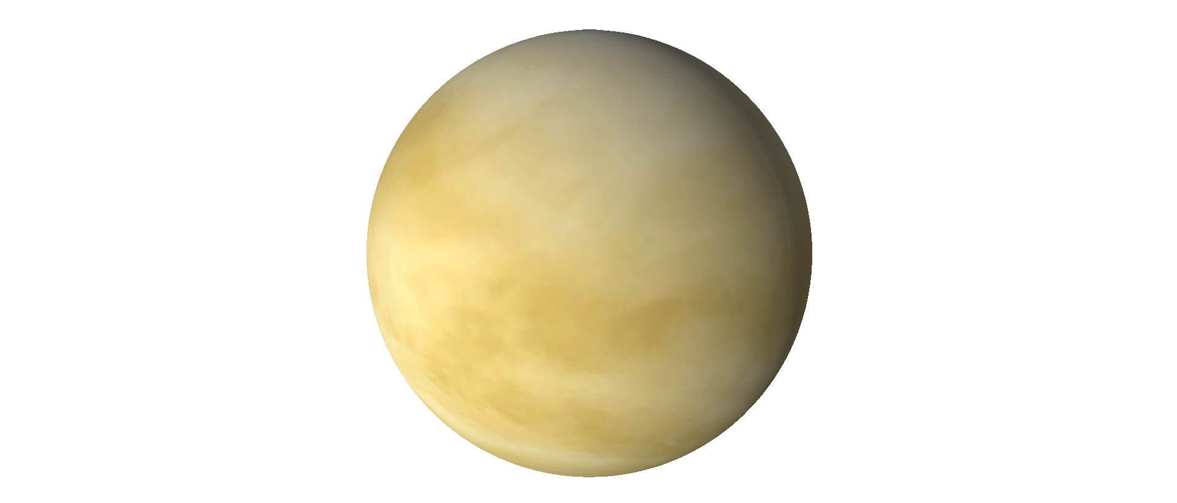
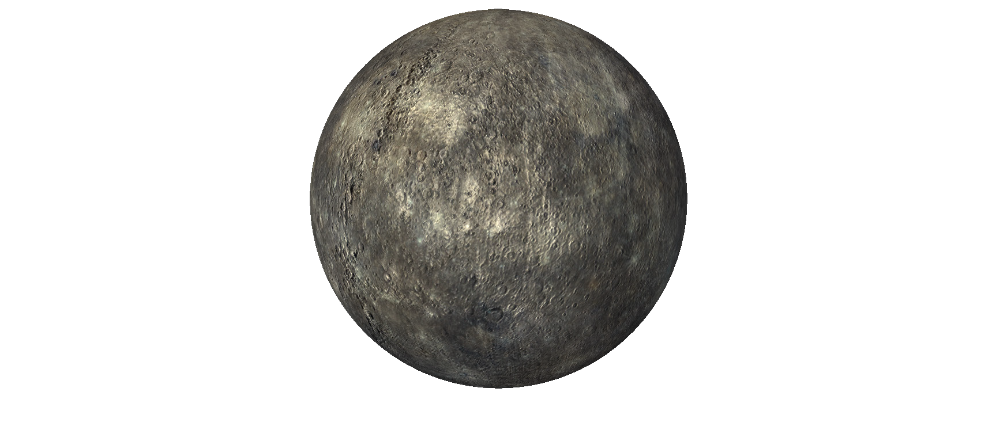
“Mercury”
“Venus”
Click to open in Lifeliqe
Click to open in Lifeliqe

Slide 8
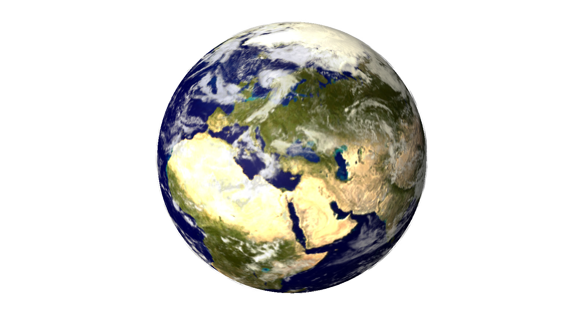
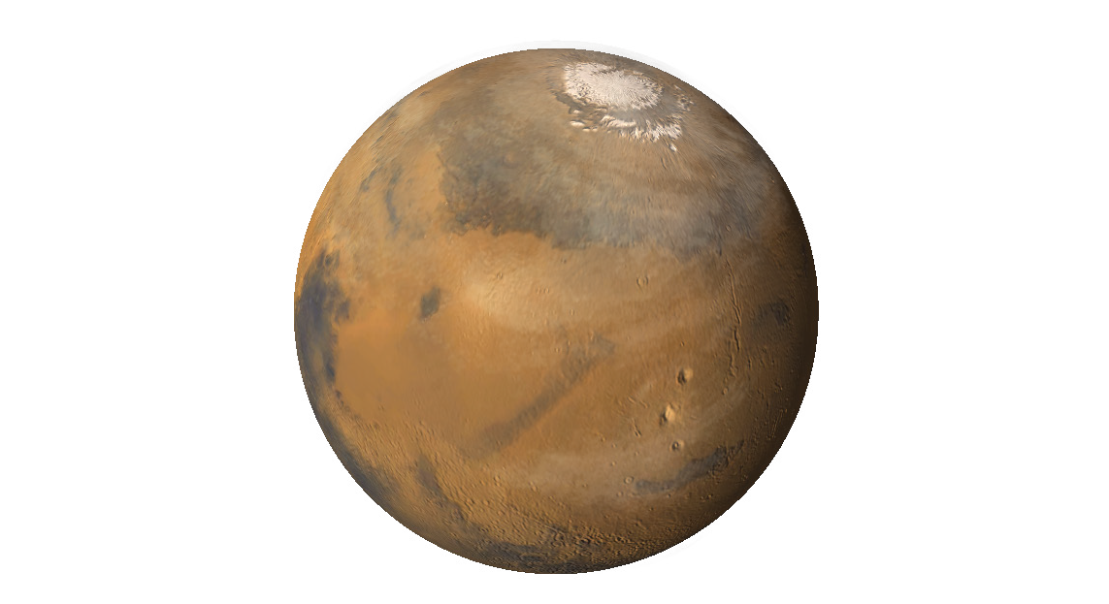
“Earth”
“Venus”
Click to open in Lifeliqe
Click to open in Lifeliqe

Slide 9
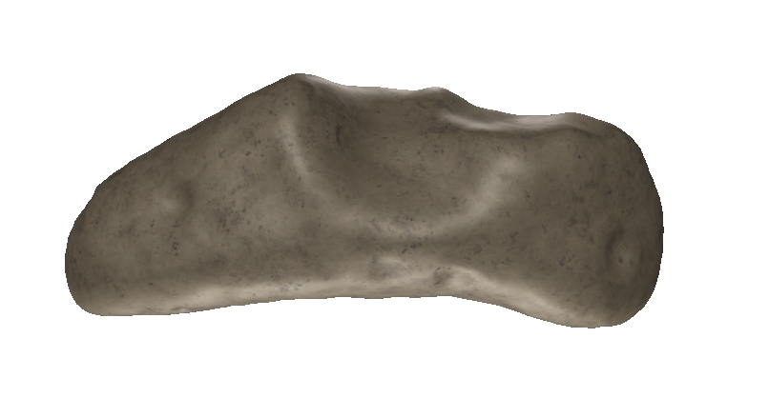
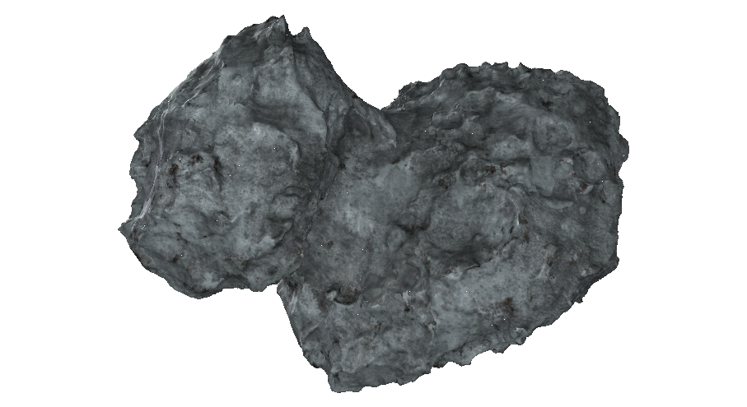
4. Earth’s anatomy
10
min
After the creation of the Solar System, Earth still didn’t have its final shape. Soon after the formation of the planet, a period of great collisions started. The Earth was bombarded frequently by objects like meteorites and comets, among others. Show your students an example of each of these objects, both found in the Astronomy library. Look for the meteorite model “Eros” and the “Comet 67P/Churyumov-Gerasimenko” model to present to students these two objects, which exist today, and to give them an idea of how objects of this type look.
However, even bigger bodies than these collided with our planet during its early years. About 4.5 billion years ago, a huge collision with a planetoid called Theia occurred. According to the most common hypothesis, this impact led to the creation of the Moon, which was formed by a gathering of the debris produced in the collision.
Click to open in Lifeliqe
Click to open in Lifeliqe

Slide 10
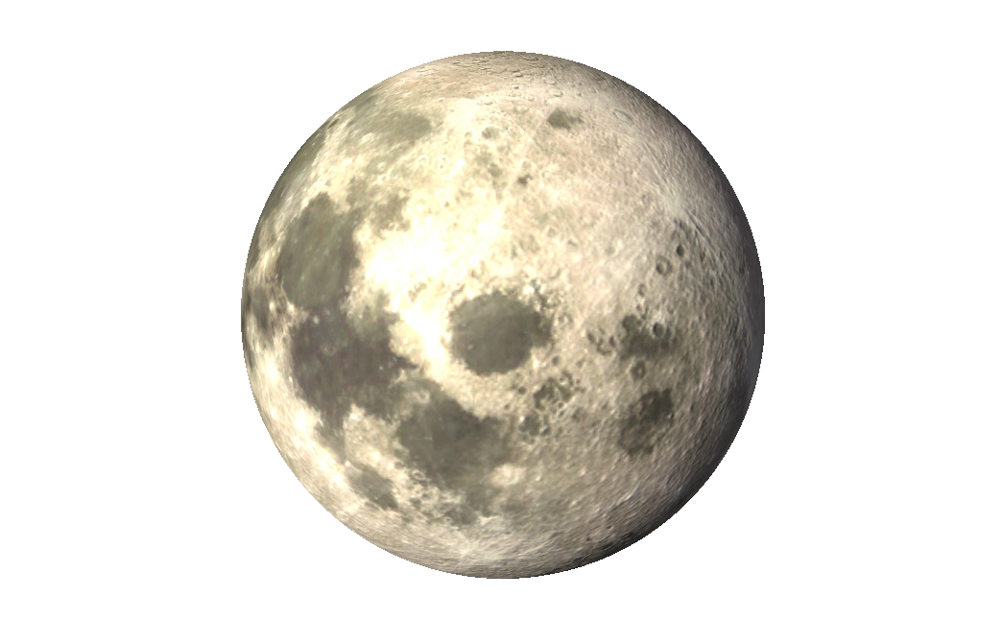
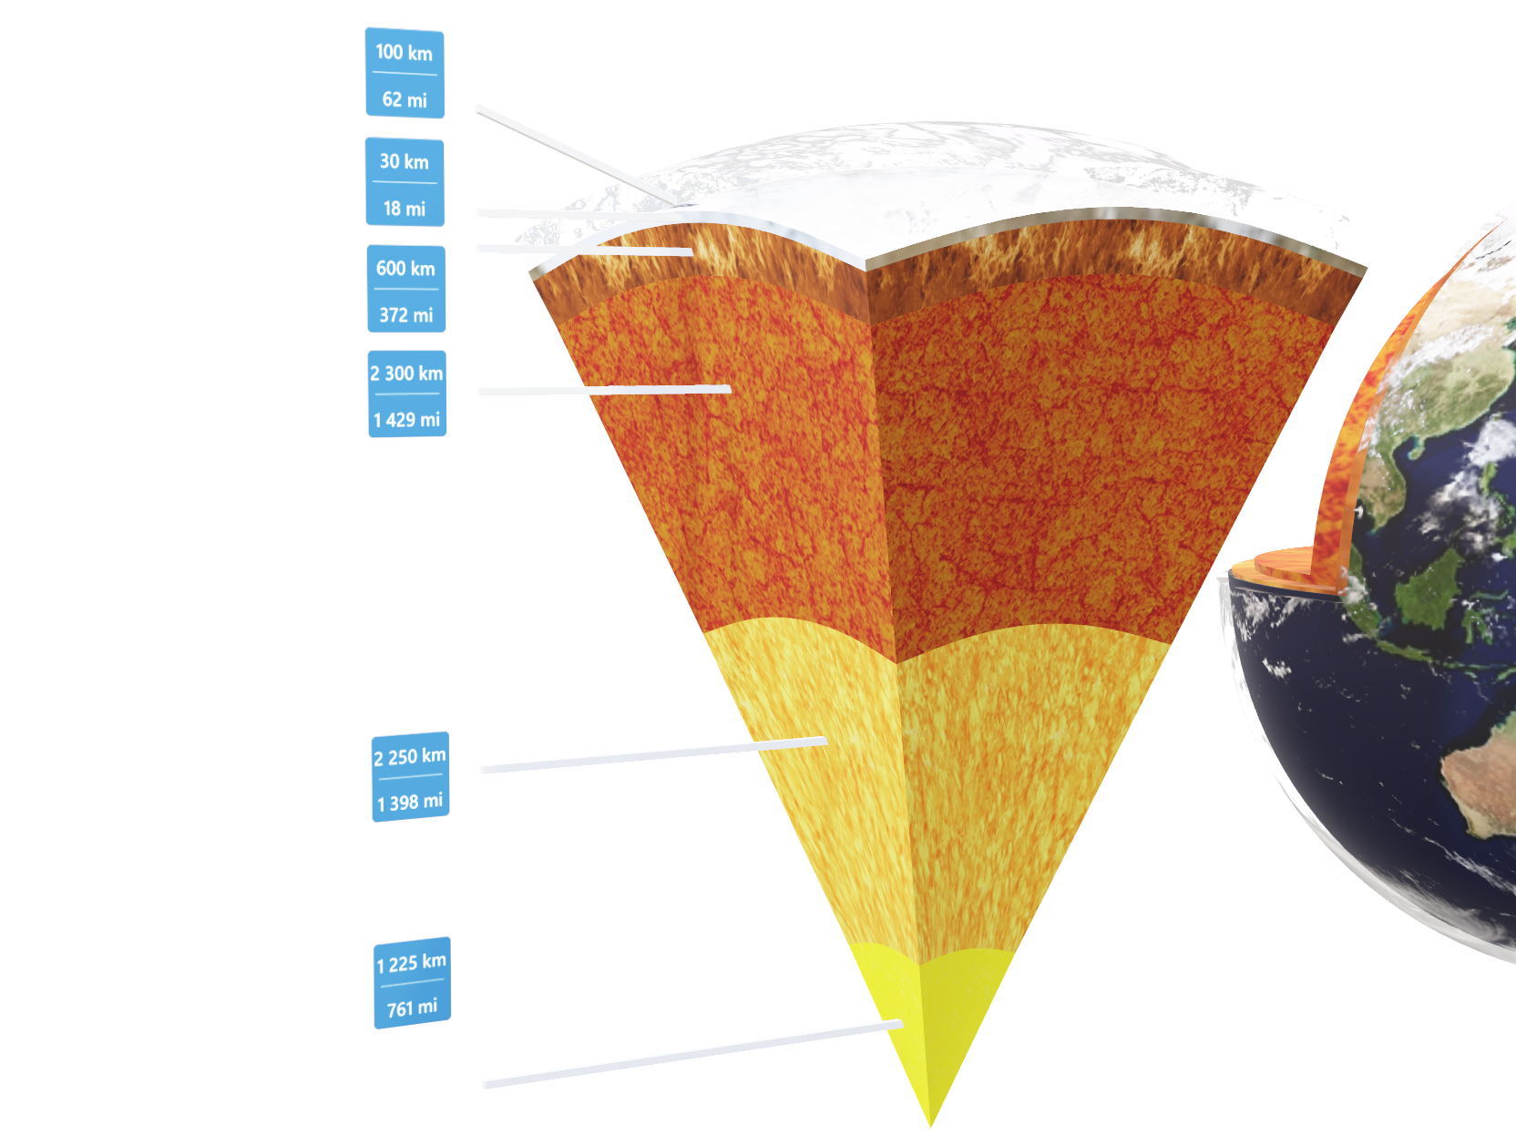
This collision theory would also explain why the Earth has a much bigger core than a normal planet of its size should have. This is because the core and mantle of Theia probably mixed with that of the Earth. To see this, open the “Earth” model again and click on its various parts to highlight each of the layers of the planet. You have at your disposal also the part Earth- V-Cut in order to make the structure more visible.
Click to open in Lifeliqe
Click on the model to interact

Slide 11
5. Extreme planets
30
min
As mentioned, the favorable conditions for life on Earth are owed in the great part to its position in the Solar System. However, in the universe there is an immense number of other planets with different, sometimes really extreme or curious conditions. Invite your students briefly to conduct research into some of these peculiar planets! Divide the students into groups, giving them some time to search the Internet for some information about these planets, then ask them to present their findings!

Slide 12

Thanks for using Lifeliqe's lesson plan!
Excite your students in learning science with 1,000+ more 3D models and lesson plans at online.lifeliqe.com

